Slide 1
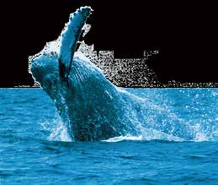
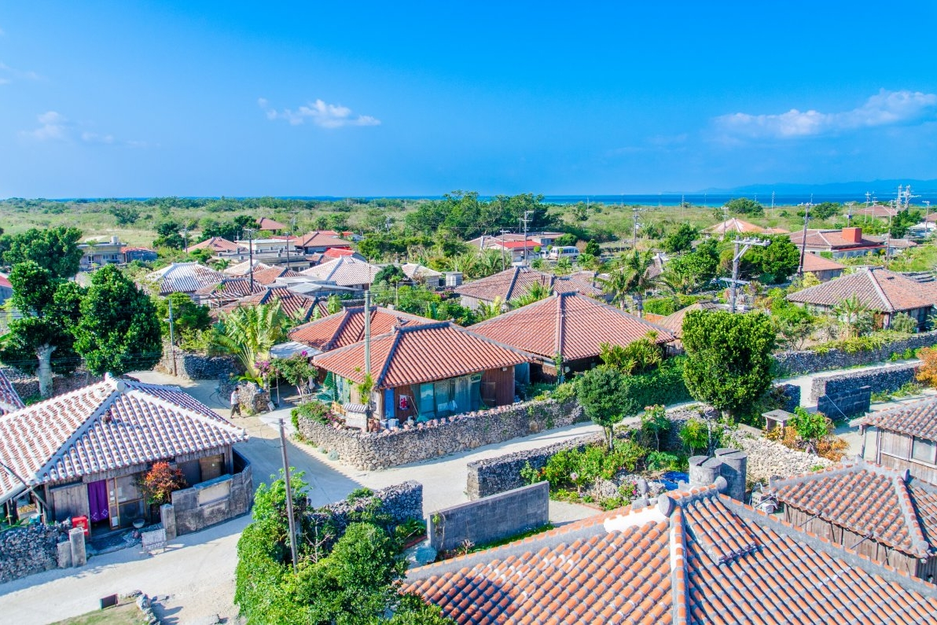
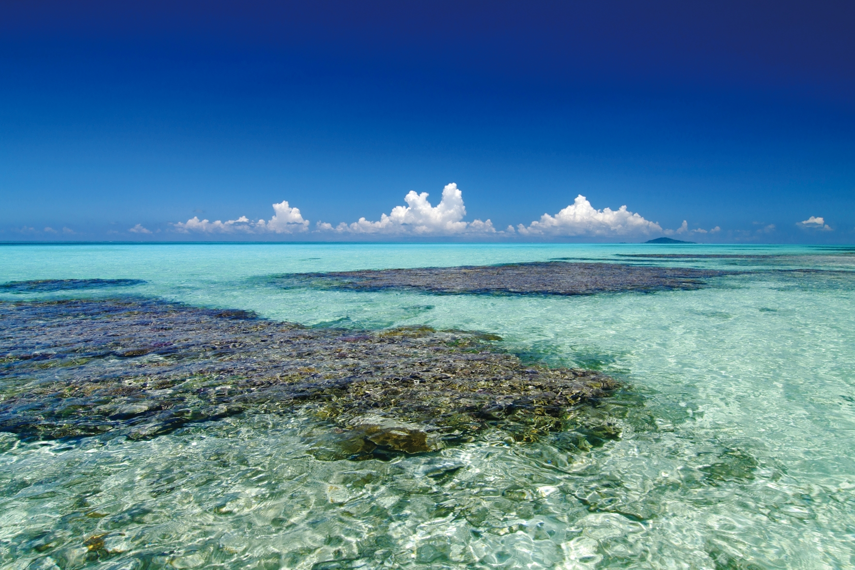
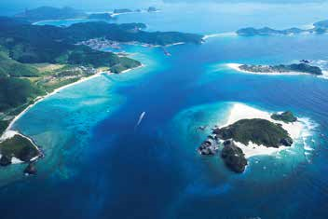
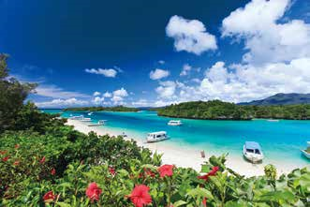
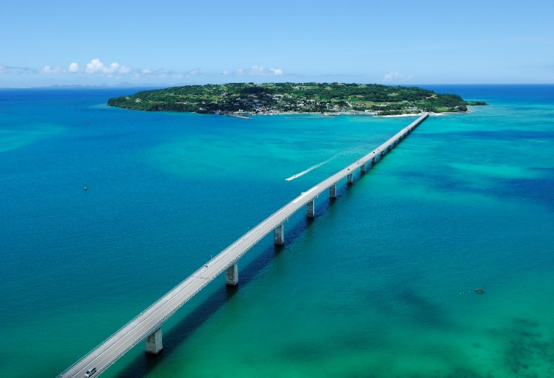
The reason why holding your MICE in Okinawa
Remote islands – Jewels of the southern sea
Kerama Islands
Yaeyama Islands
Miyako Islands
The Kerama Islands are accessible from Naha via a 40-minute ferry ride. Zamami Island is known as one of the greatest diving spots where divers all over the world come to. Tokashiki Island is popular for its crystal-clear water.
The Yaeyama Islands include Taketomi Island renowned for its red tiled roofs and the hidden Japanese treasure of the Iriomote Island. Each unique island offers a variety of activities such as jungle cruises and an experience of the traditional Okinawan lifestyle.
With its ocean and coral reefs, greenery and pure water, this area has a wonderful natural environment. The island works actively to promote sports and ecology, and you can both have fun and become educated.

